Slide 1
WEBMONK (COURSE DAY - 12)
Topics covered:
* What is React
* Single Page Application(SPA) vs Multi Page Application(MPA)
* React CLI Tool
* Component & Component Architecture
* React Internal
* Babel, Webpack
* JSX
* Lifecycle methods
* Props & State

Slide 2
WHAT IS REACT?

Slide 3
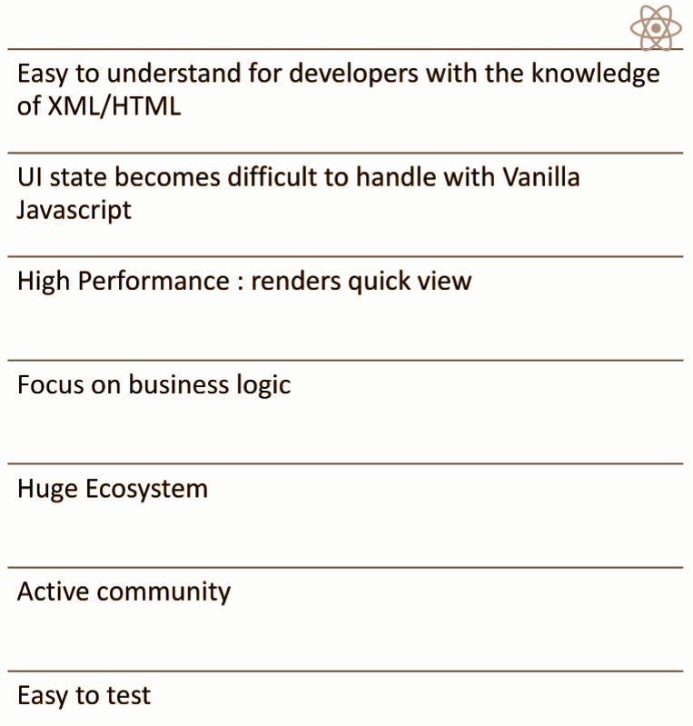
WHAT IS REACT?
React is an open-source, front end, JavaScript library for building user interfaces or UI components. It is maintained by Facebook and a community of individual developers and companies.

Slide 4
SINGLE PAGE APPLICATION VS MULTI PAGE APPLICATION

Slide 5
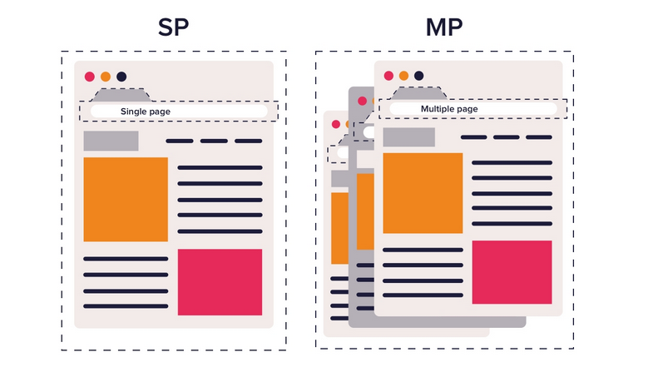
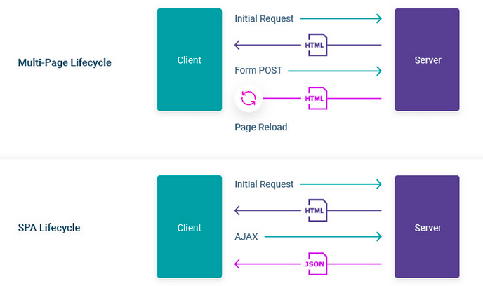
SPA VS MPA
* a Single-page Application is a type of web application loaded from one page, and all user interaction with this service is carried out, using one screen (page).
* a Multi-page Application is a web application consisting of a large number of pages completely refreshed every time when data changes on them. Any data change or data transfer to the server leads to a new page displayed in the browser.
* none of the architectures discussed above is flawless – they both have pros and cons. SPA wins in terms of speed and code reusability, which can be applied to develop your mobile app, but it has deficiencies in SEO optimization. Using an MPA will help you rank higher in Google, and is more scalable but much slower than SPA’s.

Slide 6
REACT CLI TOOL

Slide 7
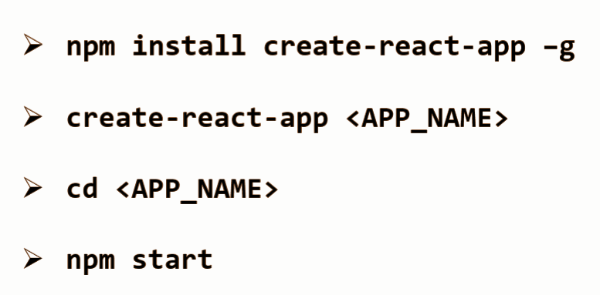
REACT CLI
to get started with React, install the React CLI Tool (create react app)
let’s run the following command to create new project:

Slide 8
COMPONENT & COMPONENT ARCHITECTURE

Slide 9
WHAT IS COMPONENT?
* components are the core building block of React apps.
* a typical React app is a component tree having one root component ("App") and then a potentially infinite amount of nested child components.
* each component needs to return/ render some JSX code
* React should render to the real DOM in the end.
* components can be nested inside other components.

Slide 10
WHAT IS COMPONENT ARCHITECTURE?
Let’s look at some examples & learn about this.

Slide 11
REACT INTERNALS

Slide 12
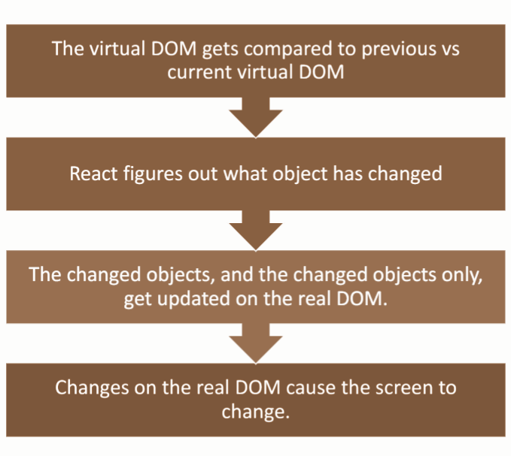
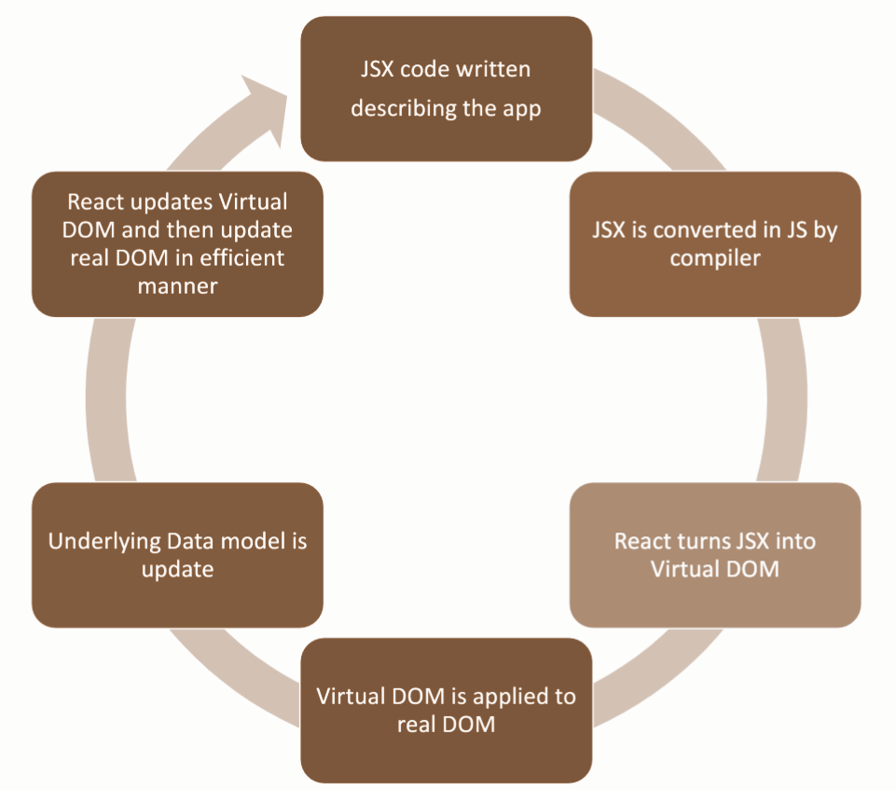
REACT INTERNALS

Slide 13
BABEL & WEBPACK

Slide 14
BABEL & WEBPACK
all the great features of ES6 come with one big problem — majority of browsers do not fully support them. That’s when Babel comes to play. Babel is a JS transpiler that converts new JS code into old ones. It is a very flexible tool in terms of transpiling. One can easily add presets such as es2015, es2016, es2017, or env; so that Babel compiles them to ES5.
Webpack is a modular build tool that has two sets of functionality — Loaders and Plugins. Loaders transform the source code of a module. For example, style-loader adds CSS to DOM using style tags. sass-loader compiles SASS files to CSS. babel-loader transpiles JS code given the presets. Plugins are the core of Webpack. They can do things that loaders can’t. For example, there is a plugin called UglifyJS that minifies and uglifies the output of webpack.

Slide 15
JSX

Slide 16
WHAT IS JSX?
* JSX comes with the full power of JavaScript.
* JSX produces React “elements”.
* you can put any valid JavaScript expression inside the curly braces in JSX.
* after compilation, JSX expressions become regular JavaScript function calls and evaluate to JavaScript objects.
* since JSX is closer to JavaScript than to HTML, React DOM uses camelCase property naming convention instead of HTML attribute names.

Slide 17
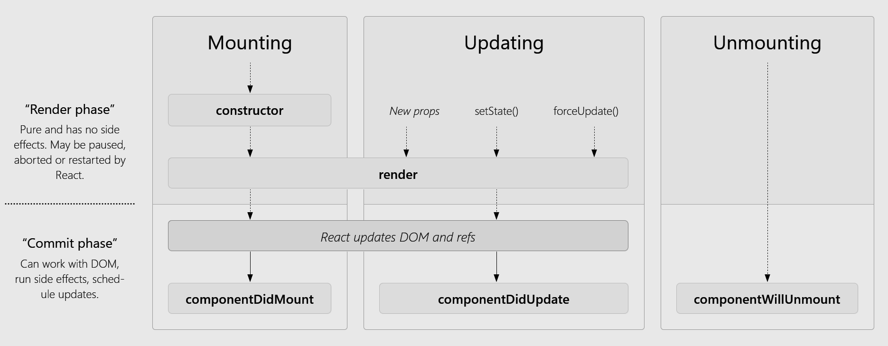
WHAT IS LIFECYCLE HOOK?

Slide 18
STATE & PROPS

Slide 19
WHAT IS STATE?
* react components can be made dynamic by adding state to it.
* state is used when component needs to change independently of its parent.
* changes to state also trigger an UI update.
* react component’s state can be updated using setState() with an object map of keys which can be updated with new values. Keys that are not provided will not be affected.
* setState() merges the new state with the old state.

Slide 20
WHAT IS PROPS?
* props allow you to pass data from a parent (wrapping) component to a child (embedded) component
* only changes in props and/or state trigger React to re-render your components and potentially update the DOM in the browser.
* props are considered “immutable”
* props are supplied as attribute to components

